Slide 1
Climate Change Amplifies PCB Toxin Risks in Southern Resident Killer Whales: A Population Model
By: Elisa Herter

Slide 2
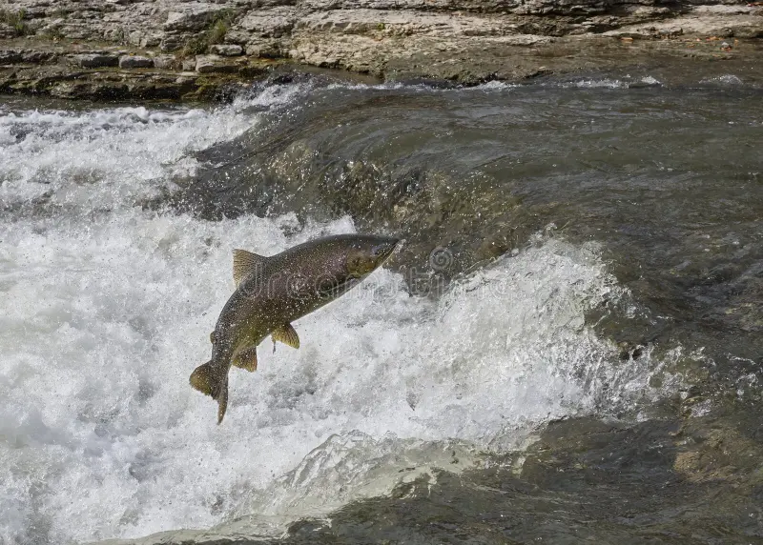
Research Question
Central Question: Does climate-driven Chinook salmon decline accelerate SRKW population collapse by amplifying internal PCB exposure through blubber mobilization?
Sub Question: How severe must prey decline be before toxin feedback drives population collapse?
Why It Matters: SRKWs (critically endangered orcas) face prey scarcity + pollutants; climate worsens both.
Jargon:
PCBs = persistent chemicals that build up in fat
blubber mobilization = fat burning releases toxins when food is low.
Fig 1: SRKW main food source, Chinook Salmon
https://thumbs.dreamstime.com/b/chinook-salmon-jumping-river-jumps-up-ledge-ganaraska-as-swims-upstream-fall-to-lay-eggs-159979140.jpg

Slide 3
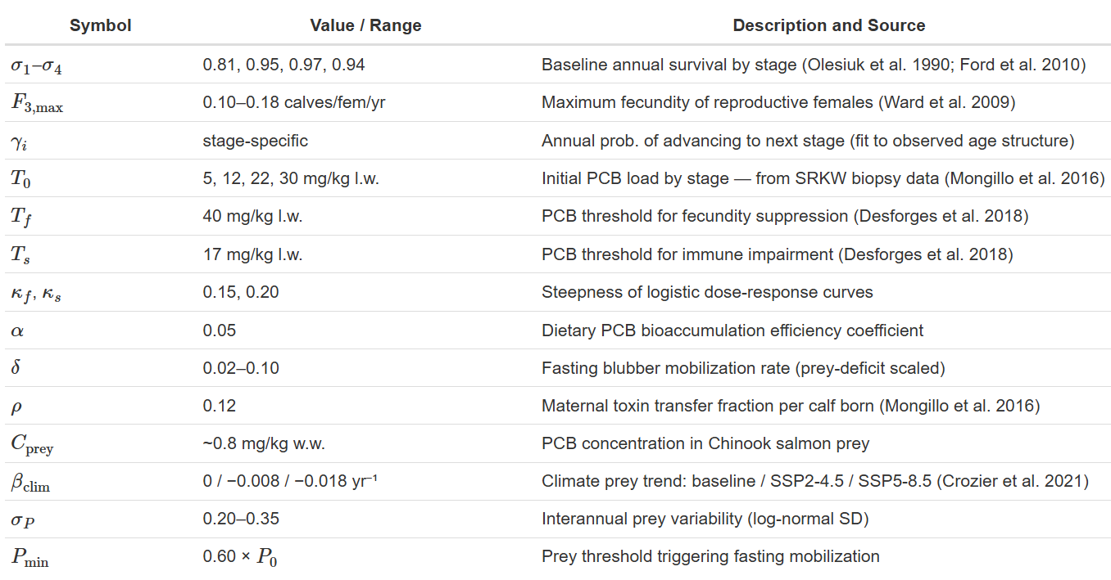
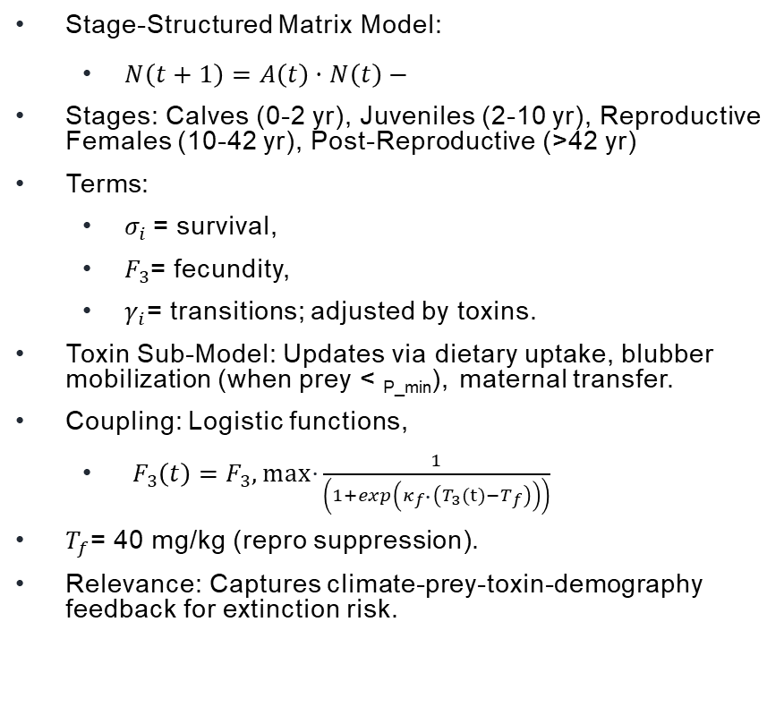
Model overview
Stage-Structured Matrix Model:
$N\left(t+1\right)=A\left(t\right)·N\left(t\right)−$
Stages: Calves (0-2 yr), Juveniles (2-10 yr), Reproductive Females (10-42 yr), Post-Reproductive (>42 yr)
Terms:
$σ_{i}$= survival,
$F_{3}$= fecundity,
$γ_{i}$= transitions; adjusted by toxins.
Toxin Sub-Model: Updates via dietary uptake, blubber mobilization (when prey < _{P_min}), maternal transfer.
Coupling: Logistic functions,
$F_{3}\left(t\right)=F_{3},max\text{⋅}\frac{1}{\left(1+exp\left(κ_{f\text{⋅}}\left(T_{3}(t)−T_{f}\right)\right)\right)}$
$T_{f}$= 40 mg/kg (repro suppression).
Relevance: Captures climate-prey-toxin-demography feedback for extinction risk.

Slide 4
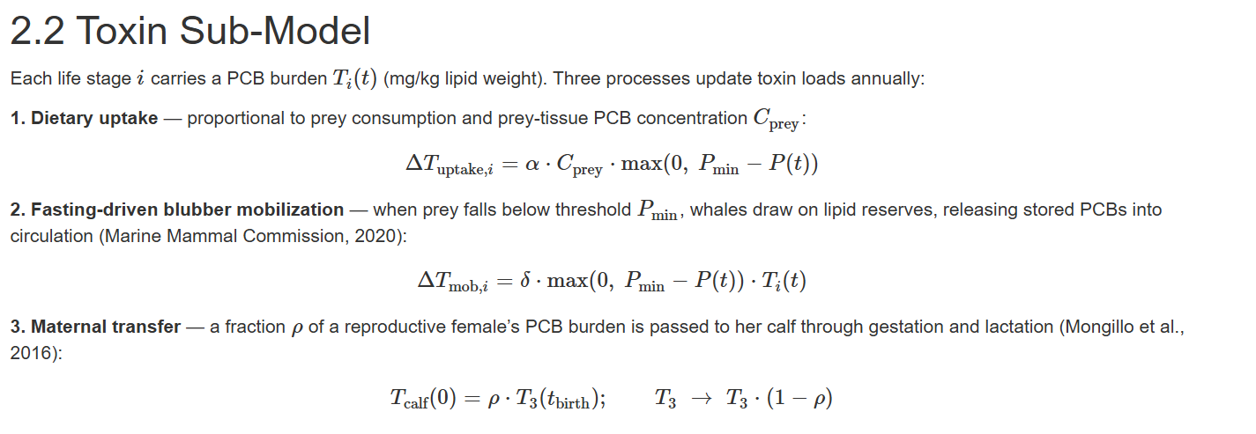

Slide 5
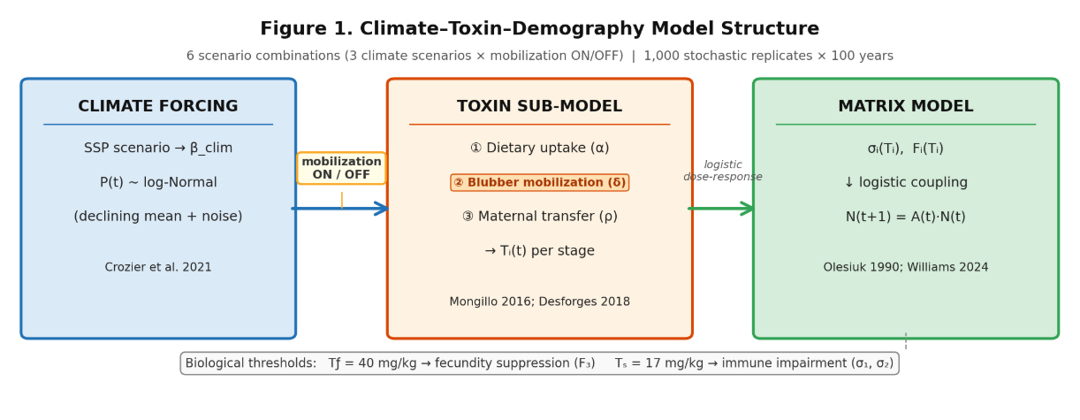
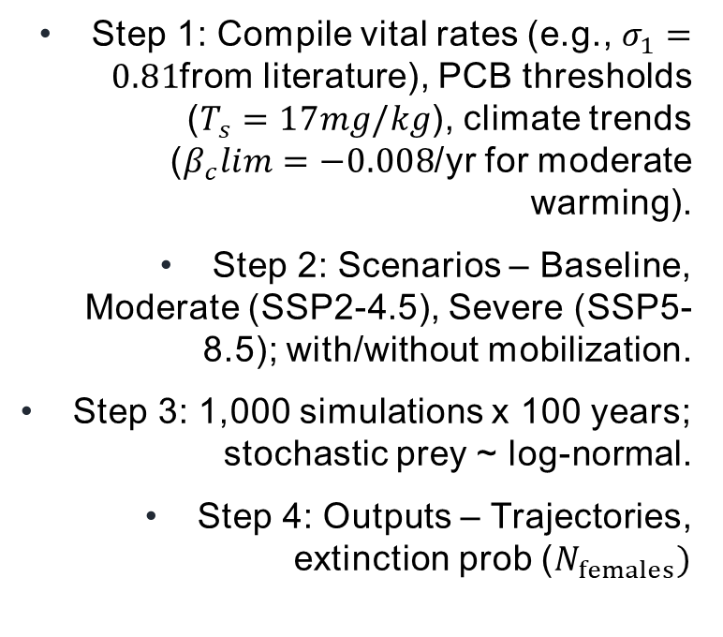
methods
Step 1: Compile vital rates (e.g., $σ_{1}=0.81$from literature), PCB thresholds ($T_{s}=17mg/kg$), climate trends ($β_{c}lim=−0.008$/yr for moderate warming).
Step 2: Scenarios – Baseline, Moderate (SSP2-4.5), Severe (SSP5-8.5); with/without mobilization.
Step 3: 1,000 simulations x 100 years; stochastic prey ~ log-normal.
Step 4: Outputs – Trajectories, extinction prob ($N_{females})$

Slide 6
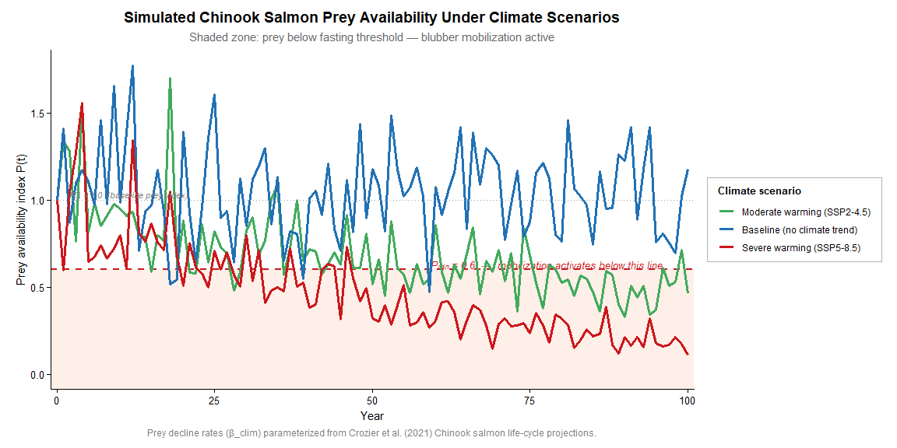
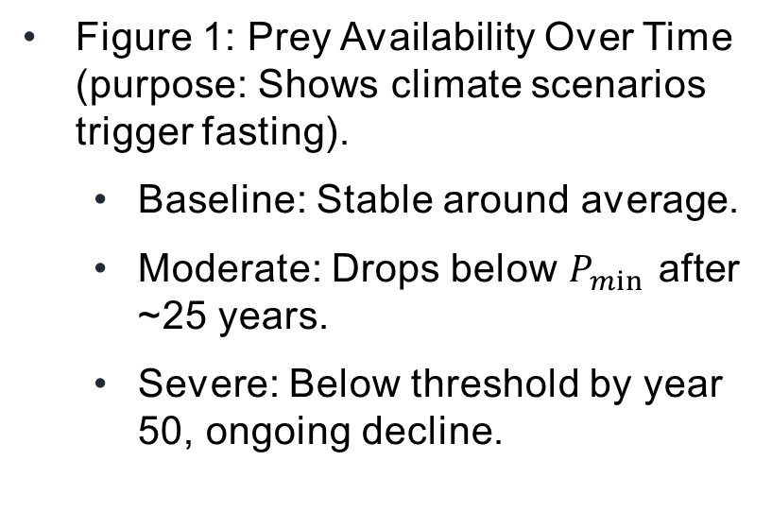
Results: Prey availability
Figure 1: Prey Availability Over Time (purpose: Shows climate scenarios trigger fasting).
Baseline: Stable around average.
Moderate: Drops below $P_{min}$ after ~25 years.
Severe: Below threshold by year 50, ongoing decline.

Slide 7
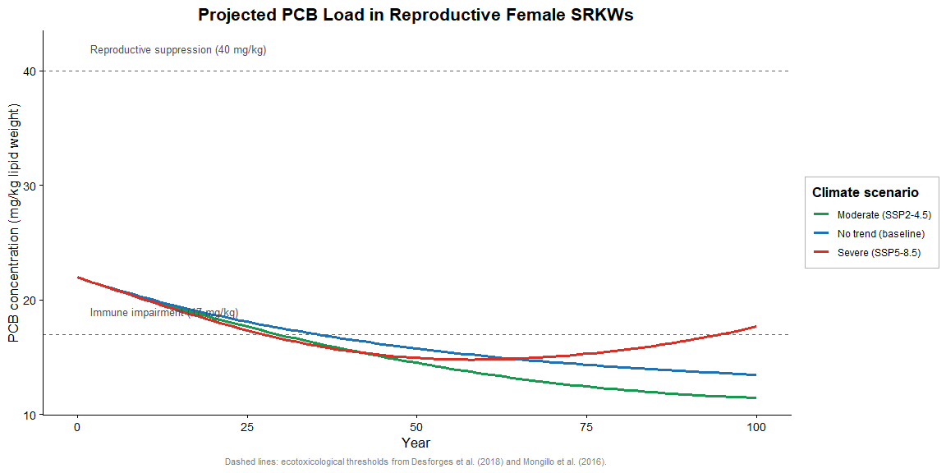
Results: Reproductive Female PCB Load
Figure 2: PCB in Reproductive Females (purpose: Tests mobilization effect).
Declines in baseline/moderate; rises in severe after ~60 years (to ~17 mg/kg).
Interpretation: Severe warming reverses PCB decline via blubber release.

Slide 8
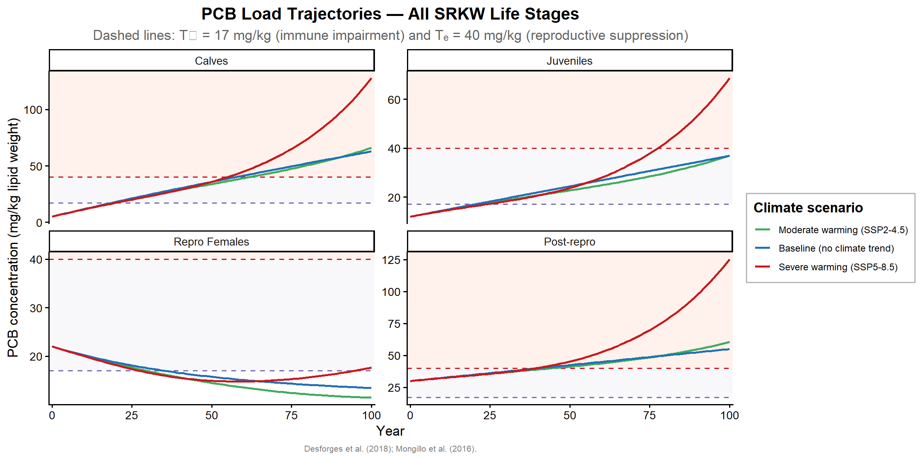
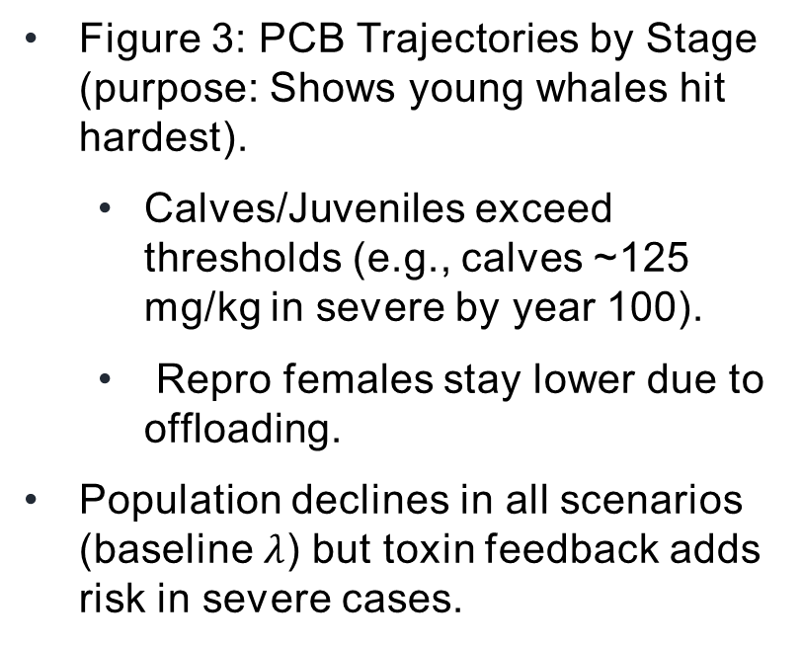
Results: PCB Trajectories by Stage
Figure 3: PCB Trajectories by Stage (purpose: Shows young whales hit hardest).
Calves/Juveniles exceed thresholds (e.g., calves ~125 mg/kg in severe by year 100).
Repro females stay lower due to offloading.
Population declines in all scenarios (baseline $λ$) but toxin feedback adds risk in severe cases.

Slide 9
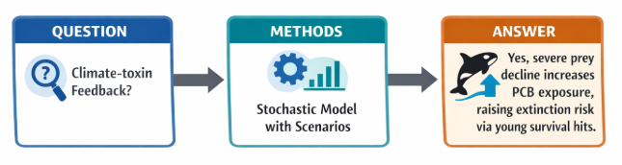
Conclusions & Overview

